Slide 1
Principles of Success in IoT
Abhay Ghatpande

Slide 2
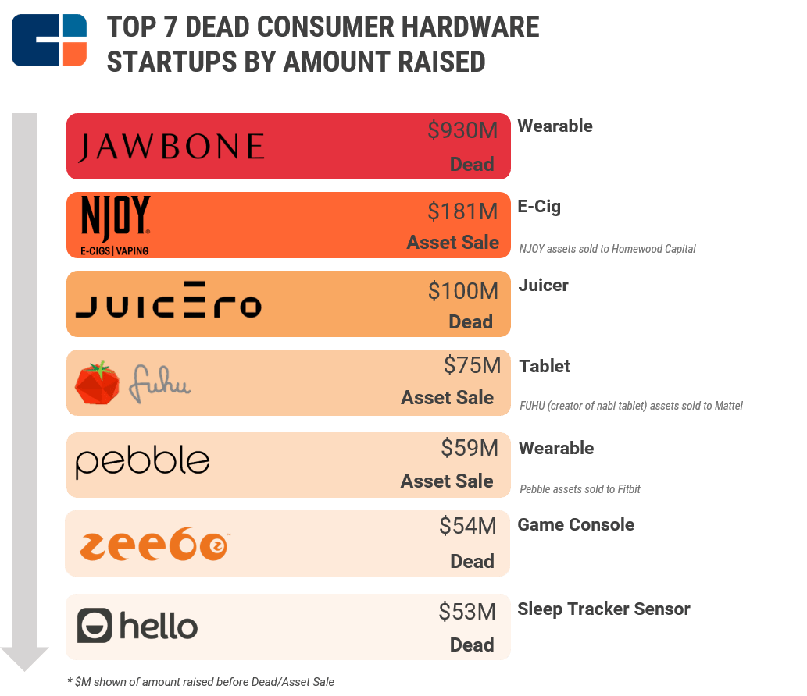
https://www.cbinsights.com/research/report/hardware-startups-failure-success/

Slide 3
Casualties in last 18 months
Juicero juicer | $118M | Skully helmet | $15M
Doppler ear buds | $50M | Narrative camera | $12M
Lily consumer drone | $49M | Jawbone | bankrupt
Sense sleep tracker | $42.4M | GoPro | 25% layoffs
Otto smart Lock | $37M | Pebble | acquired for peanuts
Teforia tea infusion | $17M | Electric Objects | acquired for peanuts

Slide 4
Industrial IoT is Faring a Little Better
Don’t require a complete reinvention of behaviours
Able to demonstrate clear ROI
Consolidation from general-purpose to industry-specific
Early days, experimentation is ongoing

Slide 5
IoT Myth 1
“Adding connectivity to an object changes everything. Once connected, dumb devices morph into objects of desire, driving strong consumer demand and commanding high prices.”

Slide 6
IoT Myth 2
“Hardware is becoming “less hard””

Slide 7
https://www.cbinsights.com/research/startup-failure-reasons-top/

Slide 8
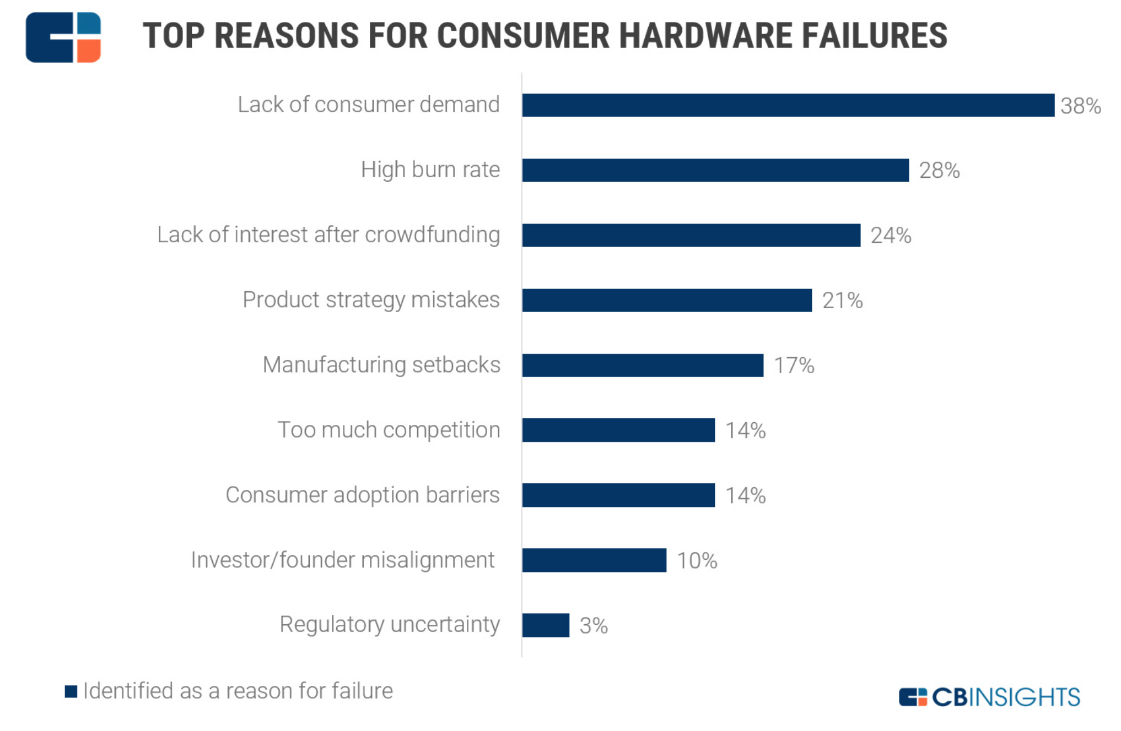
https://www.cbinsights.com/research/report/hardware-startups-failure-success/

Slide 9
Success is Simple
Build something people want to buy!

Slide 10
What do we want to buy?

Slide 11
The Fickleness of the Human Mind
We don't know what we want
We can't articulate well what we need
Everyone wants things that are faster, cheaper, better, easier, sexier, but when the time comes, we may not buy
We are terrible at predicting the future
We are irrational in our decision making

Slide 12
Why do we want to buy?

Slide 13
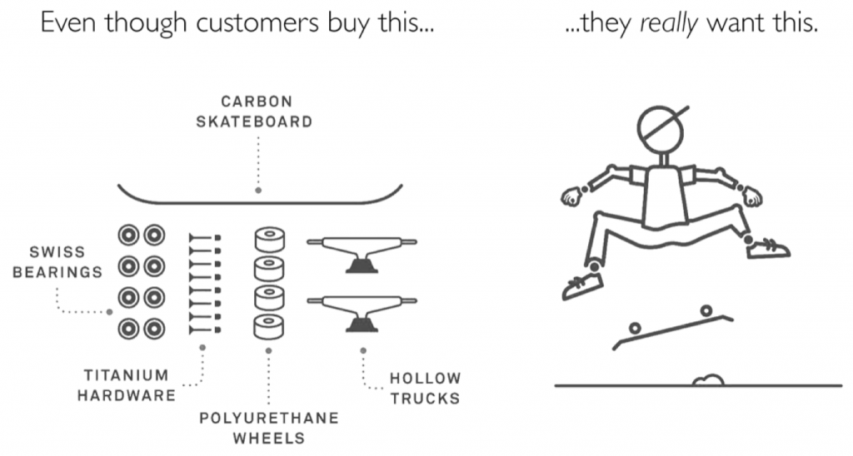

Slide 14
Successful products solve problems that customers care about in meaningful ways.

Slide 15
Every product is only a means to an end

Slide 16
Nobody buys a product because of its features

Slide 17
Principle 1
Dig Deep

Slide 18
Principle 2
Plan for Behaviour Change

Slide 19
Principle 3
Reduce Adoption Anxiety

Slide 20
Principle 4
Do not depend on scale for profitability

Slide 21
Principle 5
Do not sell technology

Slide 22
https://www.useronboard.com/features-vs-benefits/

Slide 23
Search for innovation
Observe existing users for alternative use - using product for different job than was envisioned
Observe existing users for compensating behaviours - use what’s available (imperfect) for what’s not
Study users of competing products that do the same job
Identify the why beyond the why

Slide 24
https://bhc3.com/2015/07/07/avoiding-innovation-errors-through-jobs-to-be-done-analysis/

Slide 25
Conclusion
Make the customer’s job to be done the centre of product strategy
Spend adequate time on initial customer research and validation
Fall in love with the problem, not with the technology or solution
Engage with customers at every possible opportunity

Slide 26
Thank you, and let’s solve something great!
abhay@productsuccess.ca
514-442-7661

Slide 27
Reality Check
Expanding to mainstream consumers requires undeniable value beyond the coolness factor
Design mistakes continue to be costly, supply chain problems abound, retail is difficult
Large players went from experimentation to pushing their full weight into the opportunity

Slide 28
