Slide 1
IoT Data Fabric and Use Cases in Manufacturing
Etienne Simard
IOT Networking Engineering Consultant
etsimard@cisco.com

Slide 2
Agenda
Introduction
The Challenges of IOT
Cisco Kinetic on the Factory Floor
Use Cases
Where do I Start ?

Slide 3
The Challenge of IOT

Slide 4
To get value from data
App
App
Extract & move data from things to apps
Derive business value
App
App
App

Slide 5
And these things and apps are distributed
App
App
App
App
App
App
App
App
App
App
Notes:
Adding complexity – devices may be anywhere, connecting and sending data in different ways.
And applications don’t all sit in the same place. They may be in the company’s data center. They may be in the cloud. Or multiple clouds.
Companies are dealing with highly distributed environments.

Slide 6
Challenges
App
App
App
Complexity of connecting, securing and managing diverse devices
Flexibility to compute data at the edge, data center and/or cloud
A lot of data remains locked inside its sources
No programmatic way to move right data to right apps at right time
No software control to enforce ownership, privacy & security
App
App
App
App
App
App
App
Notes:
This presents companies with a number of challenges.
--They need to securely and reliably get all those devices connected
– and that’s not easy.
-- Their data can be locked inside of their devices – as their devices all use different protocols, processes, and data formats.
--They want the ability to put compute power wherever it serves their needs best (for decision making at the right point and optimizing network resources)
--They don’t want to send all their data to every application – and they don’t have any clear way to get the right data to the right apps at the right time.
--And, as they move data they want to be able to enforce policies about ownership, privacy and security of data --- in line with both their own interest and any local regulatory and compliance.

Slide 7

An IoT network fabric is needed
App
App
App
App
App
Networking
App
Intent-Based Network + Cisco Jasper
App
App
App
App
Notes:
To meet these challenges, first you need to get devices connected – and for that you need a network.
Cisco excels at networking…
For IoT, the traditional network is the foundation, and we extend that, providing a network fabric designed specifically for IoT.
Cisco intent based network + Cisco Jasper are built to uniquely address the requirements of IoT.

Slide 8

Cisco IoT network fabric in action
Cisco Networking & Cisco Data Center
Sensors / Endpoint
Gateways
with fog compute
Routing & Switching
with Fog Compute
Enterprise
Data Centers
Cloud / Applications
1
2
3
4
5
Fast and secure
on-boarding of
IoT devices to
the network
Multiple access methods: Ethernet, WiFi, 3G/4G, LoRa, Mesh, NB-IoT...
Isolates network traffic of IoT devices with segmentation and prioritization
Meet environmental needs with portfolio of industrialized network products
Provides real-time visibility and control of connection to each IoT device
Notes:
With the IoT Network fabric you are able to:
Onboard devices—gateways, sensors – the “things in the internet of things-- quickly and securely
Engage your choice of access technologies ( cellular, wifi, ethernet, etc.)
Isolate traffic to prevent exposure of other devices on the network to IoT traffic or IoT device to IoT device. Ensure devices stay in their lanes through prioritization and segmentation.
Since different environmental requirements can be placed on IoT initiatives, we have industrialized routers, gateways, and switches to match multiple scenarios
And we ensure the connection is always available to your data destination(s) through connection management: real-time monitoring, diagnostics, automated alerts

Slide 9
But challenges remain…
Complexity of connecting, securing and managing a set of diverse devices
Flexibility to compute data at the edge,
data center and/or cloud
A lot of data remains locked inside
its sources
No programmatic way to move the right
data to the right apps at the right time
No software control to enforce ownership, privacy and security
IoT Network Fabric
IoT Data Fabric
is needed
Notes:
It simplifies getting the company’s devices reliably and securely connected.
The network is essential --
But it doesn’t address all the challenges.
There is a clear need for an IoT data fabric.

Slide 10

An IoT data fabric is needed
App
App
App
App
App
App
extracts data, computes data, and moves data
App
App
App
App
Notes:
Cisco Kinetic is a new class of software platform – an IoT data fabric – designed to address the challenges of a distributed environment.
It will:
Extract data from a your assortment of devices – and makes it usable.
Compute data to transform it, apply rules to data in motion, and perform distributed micro-processing wherever needed, from edge to destination.
Move data programmatically. Get the right data to the right applications at the right time, including multi-cloud, multi-party, multi-location. And it enforces data ownership, privacy, and security policies.

Slide 11
Cisco Kinetic Platform in action
Sensors / Endpoint
Gateways
with Fog Compute
Routing & Switching
with Fog Compute
Enterprise
Data Centers
Cloud / Applications
4
6
Execute the rules
across the system
(biz logic, ops logic)
Securely move
‘right’ data to
right apps
5
3
Visualization and intuitive UI
Enforce data privacy, ownership and security policies
1
2
Automatically
provision
gateways /
endpoints
Securely extract
and normalize data
Cisco Kinetic is a system of software running on distributed nodes of edge, data center and cloud.
Notes:
Cisco Kinetic is designed for a distributed world; it runs on but is not dependent on edge notes, gateways, fog and public cloud environments, data centers.
It serves companies with a broad range of deployment models and needs.
This system of software runs will:
Get gateways up and running and configured
Extract data securely and transform it into a usable format for your applications
Set policies about which data goes where
Execute those policies or rules – based on business logic you (the customer) have been able to set on different layers.
Provide visualization tools and dashboards with intuitive UI
Securely move data to the right applications at the right time, based on your policies and rules

Slide 12
The power of the combination
Complexity of connecting, securing and managing diverse devices
Flexibility to compute data at the edge, data center and/or cloud
Data remains locked inside its sources
No programmatic way to move right data to right apps at right time
No software control to enforce ownership, privacy & security
Diverse devices are securely and reliably connected
Compute data at all places where
it is valuable
Extracts data and makes it usable
Programmatically moves right data
to right app at right time
Executes policies to enforce data ownership, privacy and security
Notes:
A combination that addresses all 5 challenges a company faces in trying to get maximum business value from their data…

Slide 13
Cisco Kinetic Platform
Extract Data
Compute Data
Move Data
IoT Data Fabric
Gateway Management Module
Edge & Fog
Processing Module
Data
Control Module
Notes:
When companies buy the Cisco Kinetic platform they get all 3 functional models – and can dial-up additional licenses of any of the modules from this base.
Our Gateway Management Module enables our customers to:
- Automatically and securely onboard gateways.
- Remotely configure, monitor, and manage gateways from the cloud.
- Route data from the gateway to the cloud or any business application.
Our Edge & Fog Processing Module provides fully automated management of an extensible distributed computing model, with functionality to:
- Capture and transform data, normalizing it to make it usable.
- Apply rules to data in motion.
- Perform distributed micro-processing where needed, from edge to endpoint.
- Securely and reliably deliver data.
- Maintain historian data.
- Visualize data.
Our Data Control Module will address the complex needs of IoT, as it:
- Securely aggregates data from across edge, fog and cloud instances.
- Executes policies to enforce data ownership, privacy and security agreements.
- Selectively and securely routes data to applications in any mix of private clouds,
public clouds, and on premise locations.
- Manages the routing of data to any mix of cloud platforms and line of business
applications.

Slide 14
Cisco Kinetic + Cisco Networking
Extract Data
Compute Data
Move Data
Cisco
IoT Threat Defense
IoT Data Fabric
Networking
Intent-Based Network + Cisco Jasper
Notes:
Cisco IoT Threat Defense is layered on to address customers’ top concern: security
This combo of IoT Data Platform + Networking Fabric + Security uniquely solves customers’ problems

Slide 15
Cisco Kinetic on the Factory Floor

Slide 16

What Manufacturers are asking for……
48%
Reduced
Downtime
49%
Reduction
In Defects
23%
New Product Introduction
16%
OEE
Improvement
35%
Improved
Inventory
18%
Reduction in
Energy Use
Reducing unplanned downtime, improving OEE (Overall Equipment Effectiveness) and reducing energy usage are some of the most important concerns for factory owners.
Source: SCM World/Cisco “Smart Manufacturing & the Internet of Things 2015” survey of 418 Manufacturing Business Line Executives and Plant Managers across 17 vertical industries.
Notes:
[GOAL: Demonstrating Measurable Outcomes]
Talking Points/Scripting:
There is a new paradigm with digital transformation and IoT that will have significant impact to the manufacturing industry resulting in outcomes that will truly transform the manufacturing industry
According to a recent survey of 400 manufacturing business line leaders by SCM World…
Manufacturing leaders expect dramatic improvements across the key manufacturing KPIs by focusing on connecting devices in the factory and optimizing the use of data.
We did some of our own validation to define some actual values for those projected impacts.
[TRANSITION STATEMENT]
So we know that that real value is there…but how can customers capture it?

Slide 17
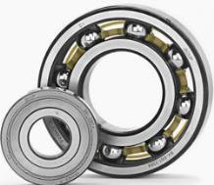
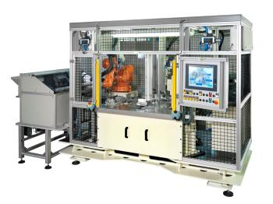
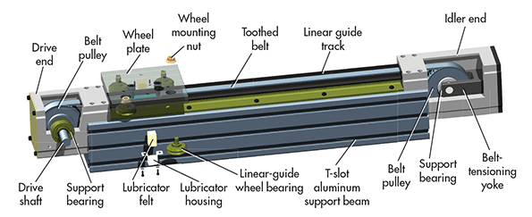
Preventative Maintenance
In equipment, moving mechanical components such as bearings wear and break before any non-moving components
As they wear vibration will begin and accelerate the rate of wear
After a certain amount of wear, more friction is introduced causing the temperature to rise
Bearings are located on motors and also on any moving part such as actuators, hinges, etc.

Slide 18
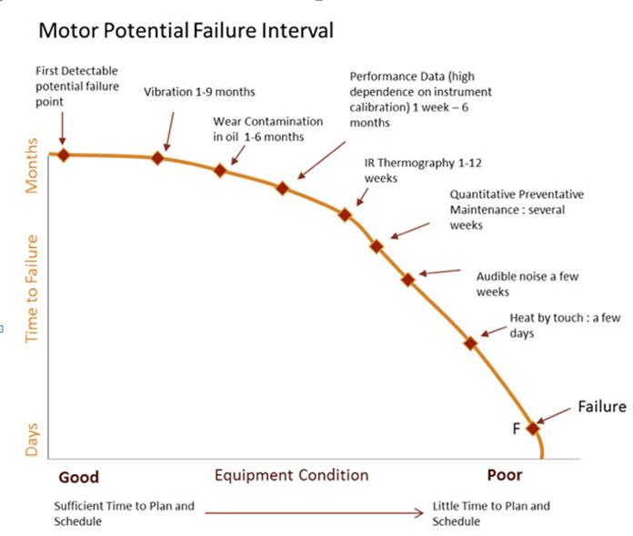
How data can prevent failure and downtime
Vibration data can help detect possible failure several months in advance.
Temperature data can give you alert of an immediate problem and possible failure.
By having this data we can schedule proper maintenance to prevent any unplanned downtime instance.

Slide 19
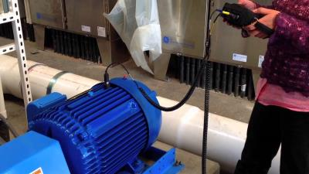


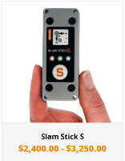
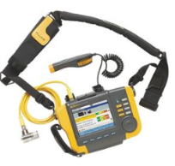
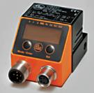
What customers are doing today
Customers/sub contractors usually perform manual spot check of motor/machine vibration every 3-6 months.
This gives them a point-in-time data evaluation. If there is deviation from last measurement they can do PM.
Very manual process, and does not give any trending data.
Can miss a possible failure between checks causing downtime.
The earlier we can detect a possible problem, the cheaper it is to fix.
$500, simple output if exceeds threshold
$ 1,050, simple monitoring
Data logger only, no real-time communication
$10,000+. Advanced unit up to 20khz.

Slide 20

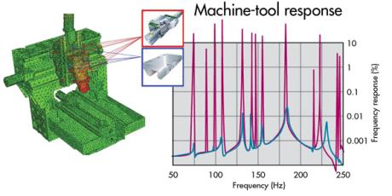
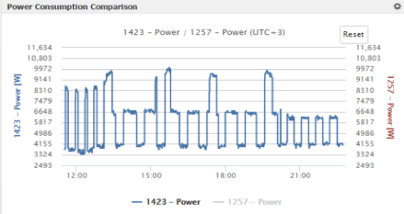
What customers are asking for
Vibration/temperature sensor solution that can be deployed quickly.
Continuous monitoring of equipment that can produce trending data and alert of possible failures.
System does not need to do advanced/detailed analytics. Customers want a simple “Check engine light”.
Simple dashboard with overview data of all monitored equipment.
Upon detection of anomaly, technician can be dispatched to investigate further.

Slide 21
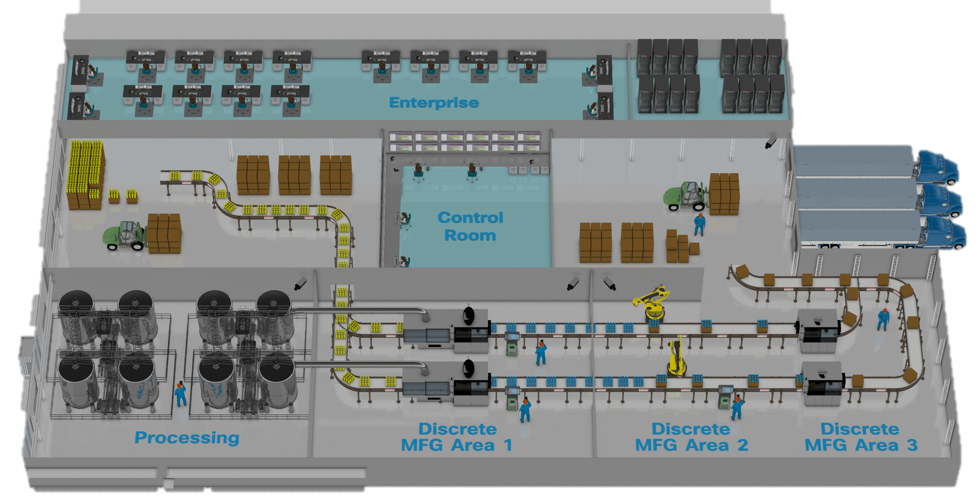
DSLink
DSLink
DSLink
DSLink
DSLink
Dashboard
Dashboard & Alerts
Todd M. Edmunds toddedm@cisco.com
Vibration Monitoring
Energy Monitoring
Energy Monitoring
Vibration Monitoring
Energy Reduction
Equipment Health

Slide 22
DSLink
DSLink
DSLink
DSLink
DSLink
DSLink
DSLink
DSLink
DSLink
Dashboard
IE
4K
w/ IOx
Dashboard & Alerts
MES / Historian
DSLink
IOx
IE
4K
w/ IOx
OEE
PLCs
Vibration Monitoring
MTConnect
Energy Monitoring
PLCs
IOx
Energy Monitoring
Vibration Monitoring
CNC / Milling Interface
PLCs
Energy Reduction
Manufacturing Visibility
Equipment Health
Plant
Efficiency
Connected Machine

Slide 23



ZDT
OEM
Analytics
DSLink
DSLink
DSLink
DSLink
DSLink
DSLink
DSLink
DSLink
DSLink
DSLink
DSLink
DSLink
DSLink
DSLink
DSLink
Dashboard
On Prem Analytics
IE
4K
w/ IOx
Dashboard & Alerts
MES / Historian
DSLink
IOx
IE
4K
w/ IOx
OEE
PLCs
Vibration Monitoring
MTConnect
Energy Monitoring
PLCs
FANUC ZDT
IOx
Energy Monitoring
Vibration Monitoring
CNC / Milling Interface
PLCs
Energy Reduction
Manufacturing Visibility
Equipment Health
Predictive Maintenance
Plant
Efficiency
Energy Reduction

Slide 24
ZDT
OEM
Analytics
DSLink
DSLink
DSLink
DSLink
DSLink
DSLink
DSLink
DSLink
DSLink
DSLink
DSLink
DSLink
DSLink
DSLink
DSLink
DSLink
DSLink
DSLink
DSLink
Dashboard
MRP
On Prem Analytics
Connected Logistics
IE
4K
w/ IOx
Dashboard & Alerts
Wireless Location
MES / Historian
DSLink
IOx
IE
4K
w/ IOx
OEE
PLCs
Vibration Monitoring
MTConnect
Energy Monitoring
PLCs
FANUC ZDT
IOx
Energy Monitoring
Vibration Monitoring
FANUC ZDT
CNC / Milling Interface
PLCs
Energy Reduction
Asset Tracking
Manufacturing Visibility
Equipment Health
Predictive Maintenance
Plant
Efficiency
Connected Machine
Supply Chain

Slide 25
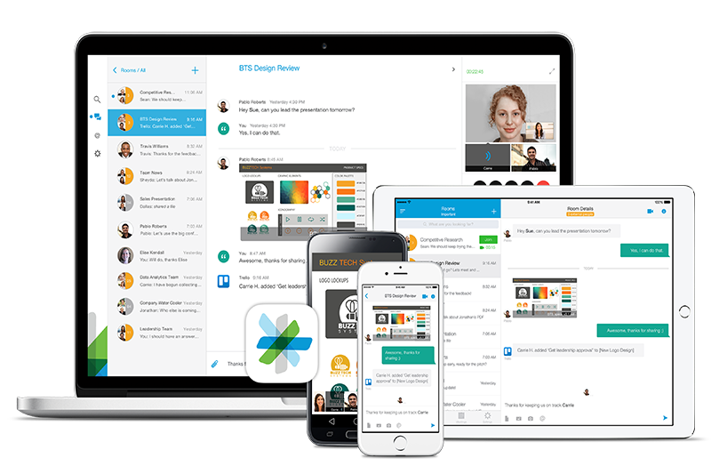
Plantwide Alarms & Alerts
ZDT
OEM
Analytics
DSLink
DSLink
DSLink
DSLink
DSLink
DSLink
DSLink
DSLink
DSLink
DSLink
DSLink
DSLink
DSLink
DSLink
DSLink
DSLink
DSLink
DSLink
DSLink
Dashboard
MRP
On Prem Analytics
Connected Logistics
IE
4K
w/ IOx
Dashboard & Alerts
Wireless Location
MES / Historian
DSLink
IOx
IE
4K
w/ IOx
OEE
PLCs
Vibration Monitoring
MTConnect
Energy Monitoring
PLCs
FANUC ZDT
IOx
Energy Monitoring
Vibration Monitoring
CNC / Milling Interface
PLCs
Energy Reduction
Asset Tracking
Manufacturing Visibility
Equipment Health
Predictive Maintenance
Plant
Efficiency
Connected Machine
Supply Chain

Slide 26
Use Cases

Slide 27


A tale of two companies
Makes and integrates
equipment (“things”)
for manufacturing
Factory owner using those things

Slide 28
These companies have a shared challenge
Better SLAs please.
Need data
and access
for predictive maintenance.
Who can help?
IT Security?
Data privacy?

Slide 29

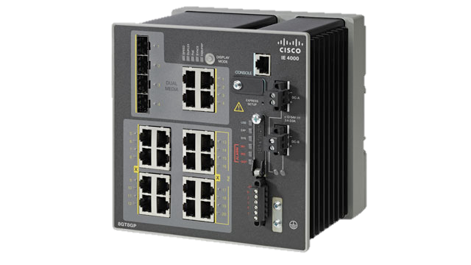
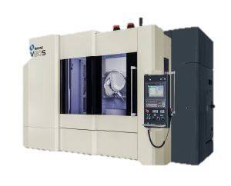
Cisco Intent-Based Network + Cisco Kinetic
IE4K
IE4K
IE4K
Factory Owner

Slide 30
New services!
Better SLAs.
Best security.
Control of my data.
Neutral Custodian
Trusted Rule Enforcer

Slide 31




Unleashing Digital Manufacturing Outcomes
Lower Downtime
Reduce Defects
Faster
NPI
Maximize
OEE
Lower Inventory
Reduce
Energy
Reduce
Risk
Make Money
Save Money
Stay out of Trouble
“$40 million downtime reduction for customer”
“Reduced labeling
error rate
by 16%”
“Shaved
10-20% off
NPI cycle time”
“Increased OEE mid 70s to high 80s”
“Reduced component tire loss by 20%.”
“Achieving 20% energy reduction with real time visibility.”
“Significantly reduced factory vulnerabilities.”
Multi-National
Brewery
Factory Network
Analytics and
Big Data
Factory Wireless with
LBS
Factory Wireless
Factory Collaboration
Factory
Network
Plant Floor Virtualization
Factory Wireless
Connected Machine
Factory
Network
Energywise
Factory Security
Notes:
We’ve seen what’s needed to achieve digital transformation. But what about their performance in the real world?
As the early adopters of these technologies have begun to deploy connected factory solutions to their businesses, our customers are already seeing impressive results.

Slide 32
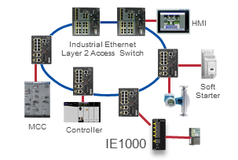
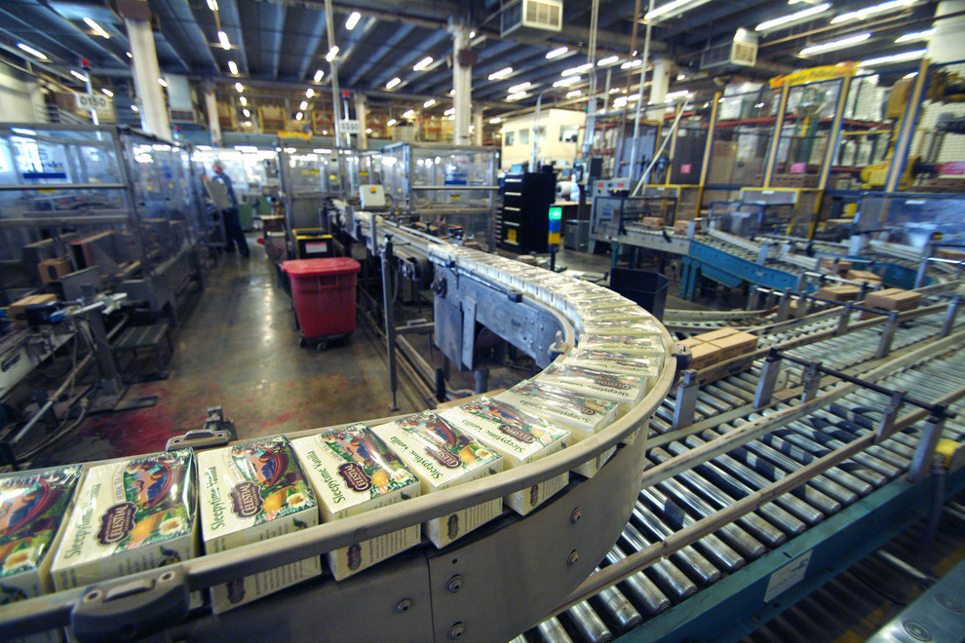
Factory Network – Securely Connect & enable OEE
Challenges
Rising operating costs and inefficient operations due to
Siloed Networks and Limited Visibility
Un-Planned Downtime
Business Outcomes
Improved OEE due to monitoring and rapid fault isolation
Zero Downtime (ZDT) due to visibility and predictive maintenance
Improved quality due to Accurate Component visibility and traceability
Operational Efficiency, reduced costs, through secure integration of factory floor with business networks and real-time visibility to business applications
Solution
Industrial Ethernet 2000 ring to securely connect all factory floor devices
Industrial protocol (Profinet, CIP) interoperability
Notes:
7-12% improved OEE due to monitoring and rapid fault isolation
Improved Build to Order (BTO) cycle by 25% with assembly line changeovers
Zero Downtime (ZDT) due to End-to-End process Monitoring
Improved quality due to Accurate Component visibility and traceability
IE 2000/4000 switches provide:
Connection between all devices on IP
Rapid Fault isolation and highly resilient network via REP (Resilient Ethernet Protocol)
Support for factory-centric protocols (Ethernet/IP, Profinet, MRP, PTP, 1588, NAT)

Slide 33





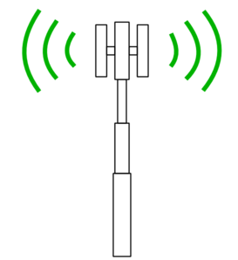
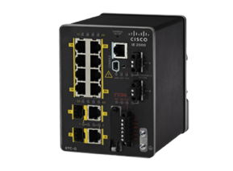
Roadside Connectivity
Business Outcomes
ROADSIDE
Safe, Smart and Eco-friendly roadways through
Connectivity for roadside systems
Increased visibility into traffic conditions
Improved monitoring of environmental conditions resulting better compliance
Infrastructure for safety systems / DSRC
Serial Port Adapter
Traffic Signal Controller
Video Encoder
Field Cabinet
LAN Switch
Cisco Solution
Safe, Smart and Eco-friendly roadways enabled by Ruggedized Industrial connectivity that can withstand extreme outdoor conditions.
Industrial Ethernet switches provide connectivity to multiple systems: ramp meters, digital signs, video surveillance, noise sensors, pollution sensors, traffic monitors, autonomous vehicle systems
Multiple uplink ports for redundant connectivity to the citywide MPLS transport network
IR829
IE2K
Customer : California Highways, Georgia DOT
Notes:
Safe, Smart and Eco-friendly roadways through
Connectivity for roadside systems (ramp meters, digital signs, video surveillance), resulting in reduced traffic congestion, improved safety
Increased visibility resulting in fewer incidents and shorter time to clear accidents, reducing secondary incidents
Improved monitoring of environmental conditions by connectivity to noise/pollution sensors and traffic monitors, resulting better compliance
Enabling the infrastructure for autonomous vehicle systems

Slide 34
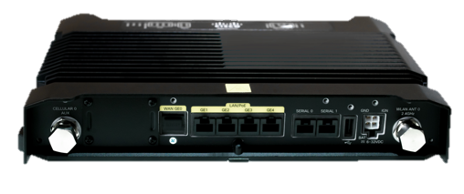

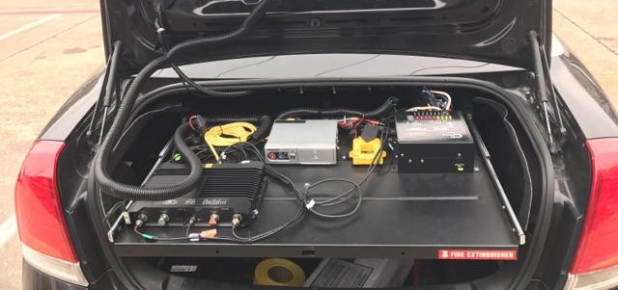
Police Vehicles & Public Safety – Extension of the Station
Challenges
Service Provider 1
Service Provider 2
Poor incident response and lower productivity due to
Lack of Mission-critical connectivity to share real-time information
Multiple disparate systems on vehicle
Active
Active
LTE Radio 1
LTE Radio 2
Business Outcomes
IR829
Enhanced incident response and Improved Productivity
Single integrated network for all in-vehicle systems
Precise tracking of the personnel and vehicles
GPS
Enhanced incident response and Improved Productivity due to Uninterrupted, Ruggedized network connectivity for mission-critical operations.
Cisco Solution
Cisco IR829 Dual LTE provides
Dual-WAN - redundancy and higher bandwidth
In-vehicle WiFi network for all systems
GPS for location; OBD for Telematics / Diagnostics
Customer: Olathe City, Kansas
Notes:
Improving Operations, reducing Opex
Increasing mobility for under the wing operations
Need for real time critical communications between Pilots, underwing teams, flight operations and other mobile airline employees
Network connectivity that can withstand extreme outdoor conditions
United CIO wanted to increase mobility for under the wing operations improving GS Operations and increase on-time plane departures
Provide real time critical communications between Pilots, underwing teams, flight operations and other mobile airline employees
United Airlines required to find a way to reduce plane turn time, and provide additional connectivity to the jet bridge while reducing the cost most for IT support on the jet bridge.
Reducing plane turn time
Increasing on-time plane departures

Slide 35
Where do I Start ?

Slide 36

Digital Manufacturing Journey
- 49%
Defects
+ 16% OEE
+ 23%
NPI
- 48%
Downtime
- 35%
Inventory
Supply Chain
Orchestration
Connected
Enterprise
Supply Chain Collaboration (SXP)
Design Collaboration
Connected
Factory
Analytics & Big Data
Virtualization & Compute
Connected Machines
Factory Collaboration
Location Services
Off-Line
Factory Network
Factory Security
Factory Wireless

Slide 37

Digital Manufacturing Solutions
Supply Chain Collaboration
Factory Collaboration
Apps
Analytics & Big Data
Factory Virtualization
Data Center and Cloud
Compute
Connected Machines & Edge Compute
Factory Wireless
Connected Factory Infrastructure
Factory Security
Factory Network
Notes:
Cisco is driving these solutions through our comprehensive set of offerings that enable digital manufacturing. From a unified infrastructure up through compute platforms and applications, Cisco is the ideal partner to help you achieve the holistic approach.

Slide 38
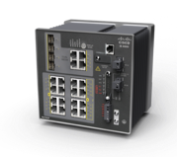






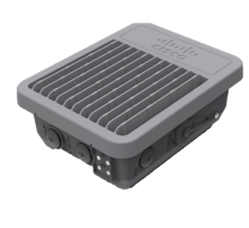




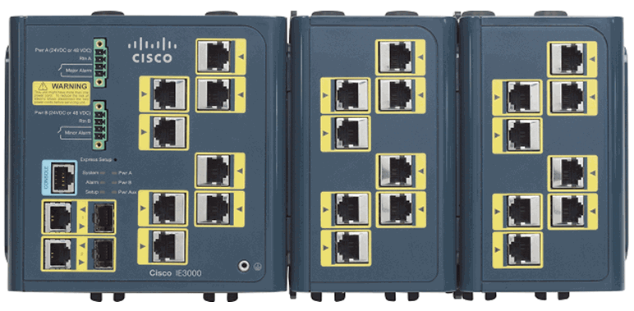





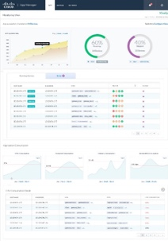
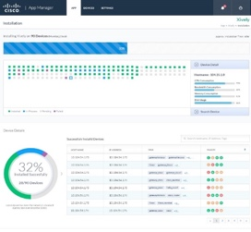




Cisco IoT Networking Portfolio
Transportation
Utilities
Transportation
Manufacturing
Buildings
Industrial
Switching
IoT
Gateways
Industrial
Routing
Low Power Wide Area
LPWA
Industrial
Wireless
IE 1K,2K,3K,4K,5K,
CGS
IR819, IR 809/829
ASR 902/903,
CGR 1000, CGR 2000
LoRaWAN
IXM Gateway
AP1552, AP1572,
IW3702
Industrial
Security
Embedded
Networks
Edge
Computing
Management and Automation
Field Network Director
Industrial Network Director
ISA 3000
ESS, 5900 ESR
5921 SW ESR
Iox, Fog,
Kinetic

Slide 39
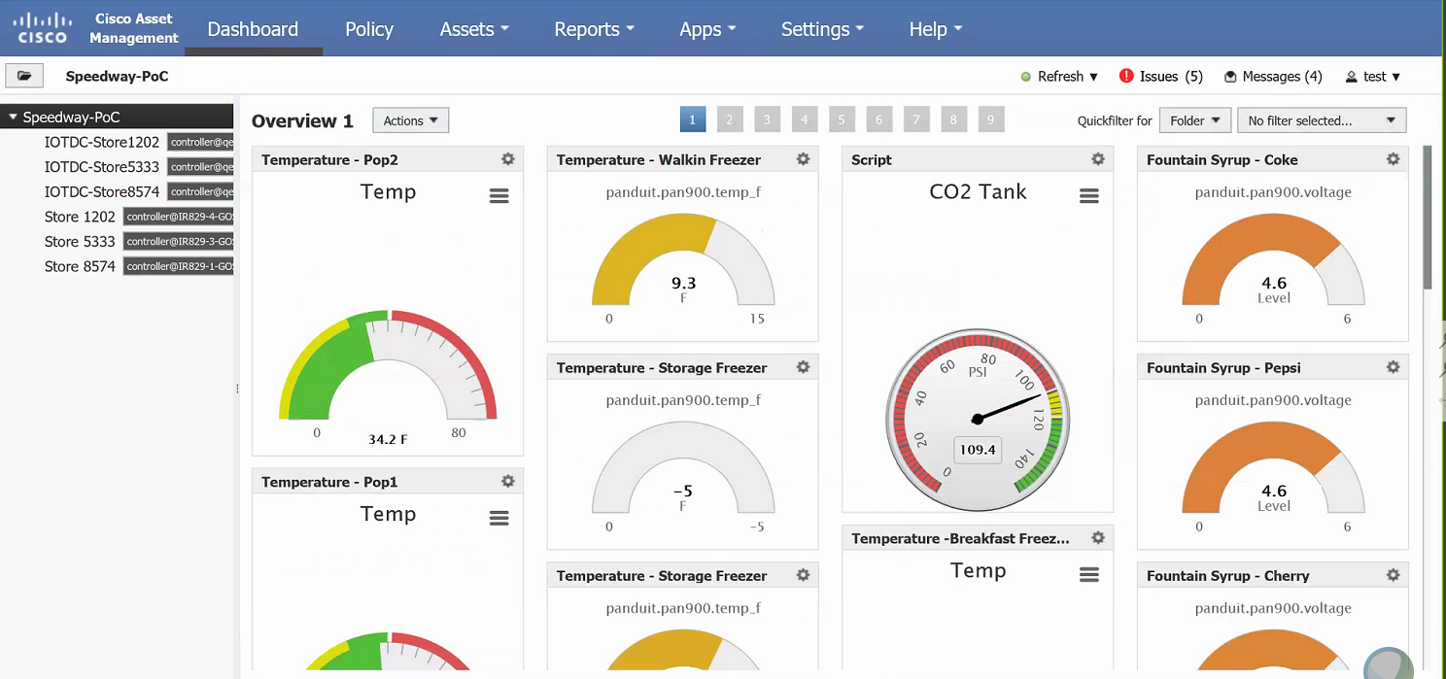
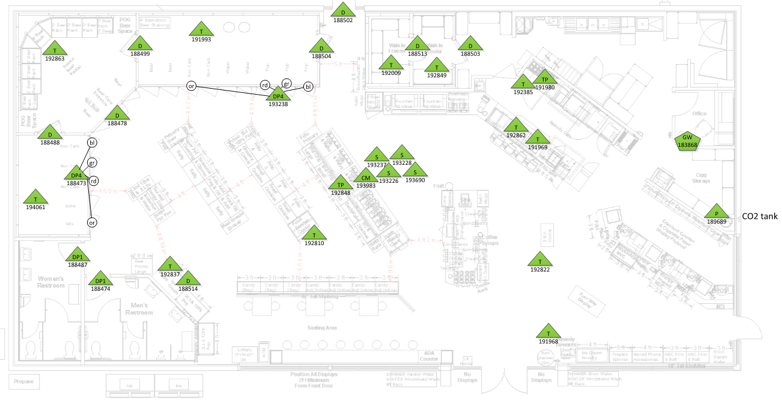
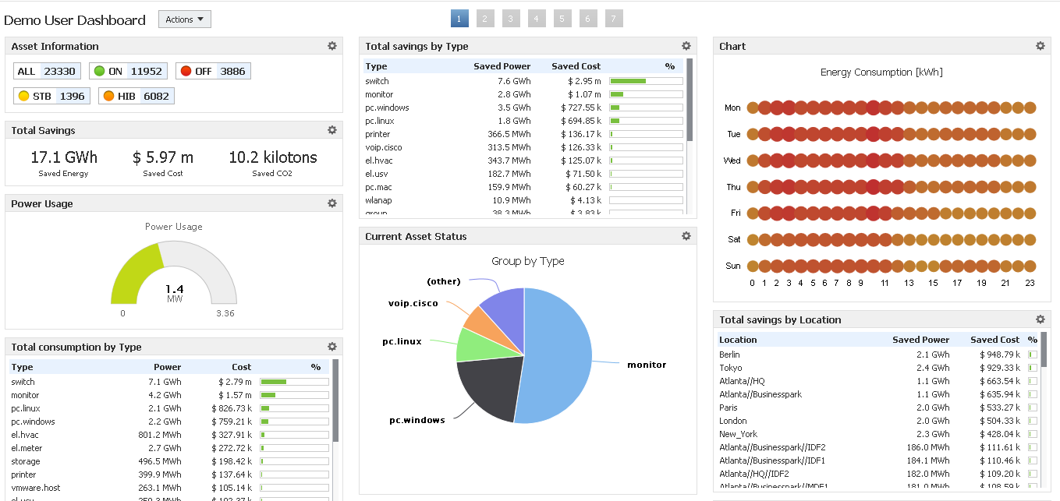

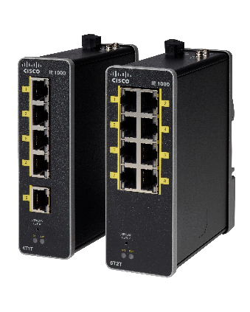


Kinetic for Manufacturing:
Energy Monitoring Starter Solution
Business Value Proposition
Cisco Kinetic
Enables manufacturers to prove out the value of monitoring energy consumption with granular visibility into consumption by machine, line, area and floor
Bundle Composition
Cisco Kinetic
Edge & Fog Processing
Cisco Kinetic Fog Fabric
(50 lic, 6mo fix-term sub)
Cisco Industrial Ethernet 1000 Switch
8 meters
(single and 3-phase electrical meters)
Single Phase Electricity Meter
Three Phase Electricity Meter
Notes:
This Starter solution is one of the ‘ready to go’, turnkey use cases for Kinetic for Mfg.
Ordering Guide will be posted here: https://cisco.jiveon.com/docs/DOC-1823601
For more information, please contact: cisco-kinetic-mfg-starter-sols@cisco.com

Slide 40
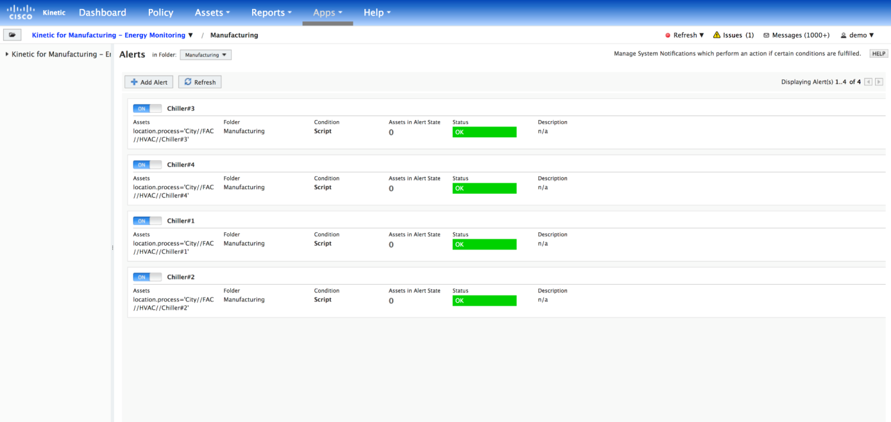
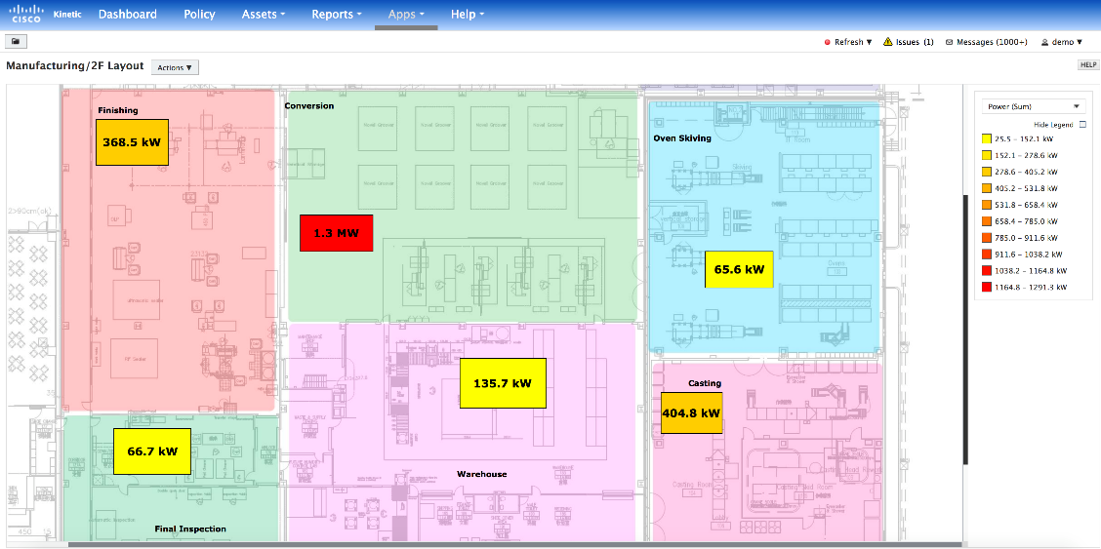
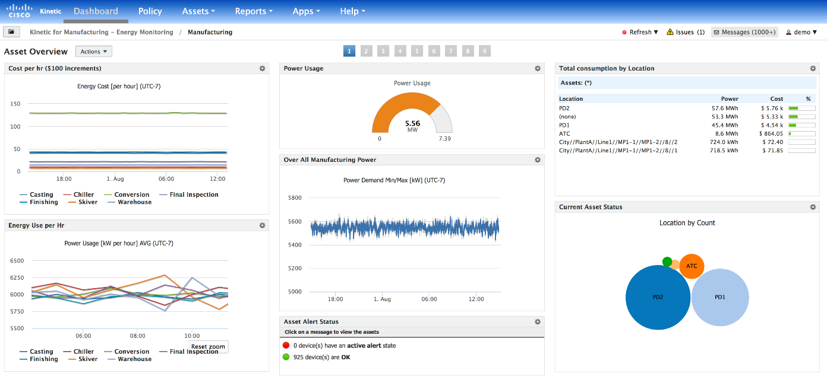
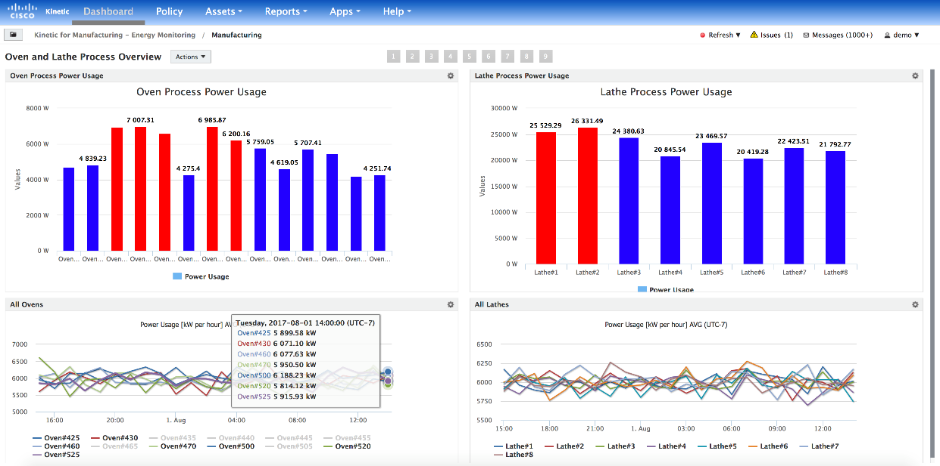


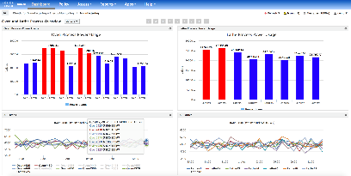
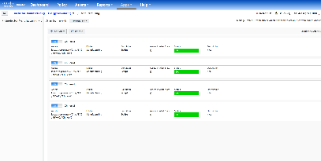
Energy Monitoring Dashboard
1
1
1. Summary Dashboard
1. Summary Dashboard
1. Summary Dashboard
2. By Function Area
2. By Function Area
2. By Function Area
3. By Product Line
3. By Product, Load
3. By Product Line
4. Alert Overview
4. Real-time alert
4. Alert Overview
2
3
4
2
3
4

Slide 41


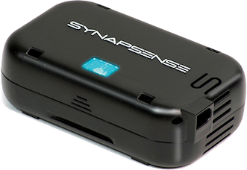
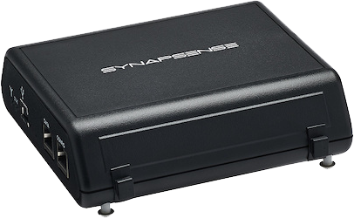
Kinetic for Manufacturing:
Equipment Health Monitoring Starter Solution
Business Value Proposition
Cisco Kinetic
Enables manufactures to prove out the value of proactively monitoring equipment condition to reduce unplanned downtime and improve equipment effectiveness
Bundle Composition
Cisco Kinetic
Edge & Fog
Processing
Cisco Kinetic Fog Fabric
(50 lic, 6mo fix-term sub)
Cisco Industrial Ethernet 1000 Switch
10 sensors
(temp., vibration & sensor gateway)
Vibration
Sensors
Temperature
Sensors
Notes:
Ordering Guide will be posted here: https://cisco.jiveon.com/docs/DOC-1823601
For more information, please contact: cisco-kinetic-mfg-starter-sols@cisco.com

Slide 42
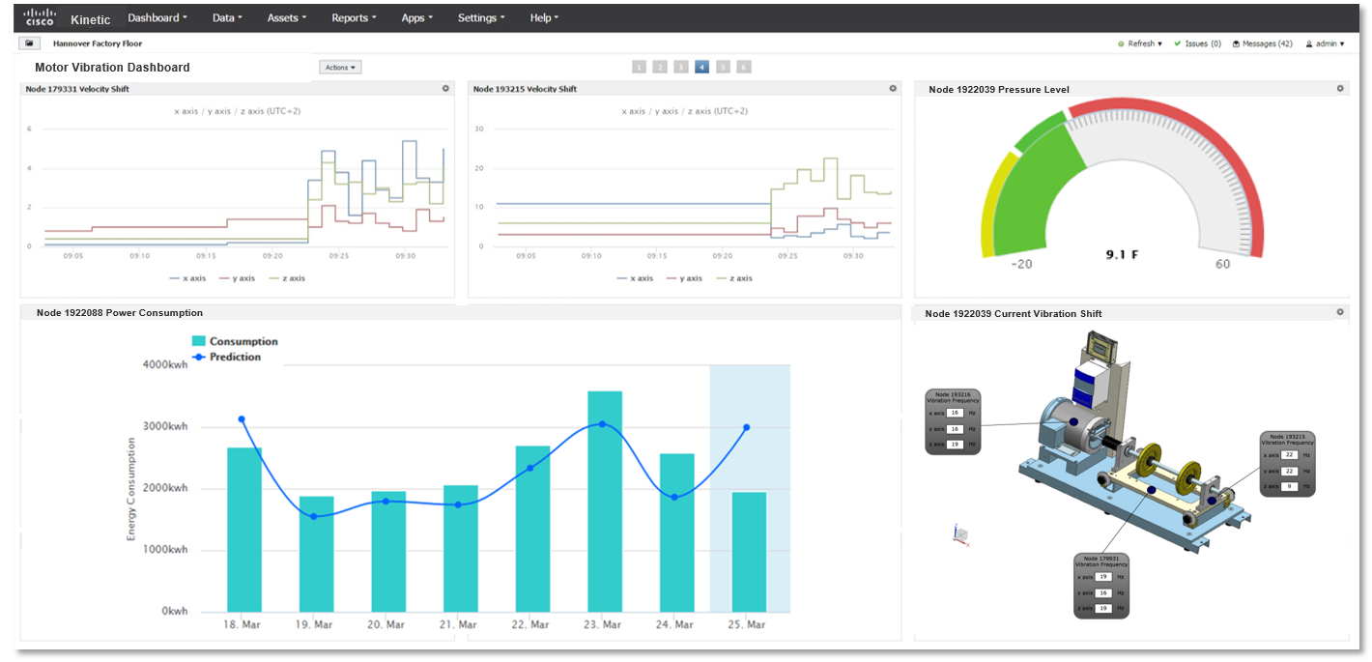
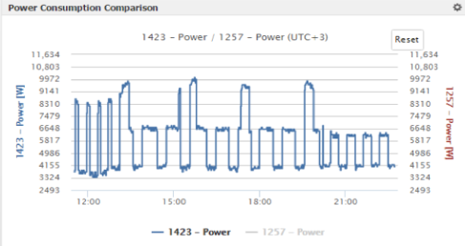
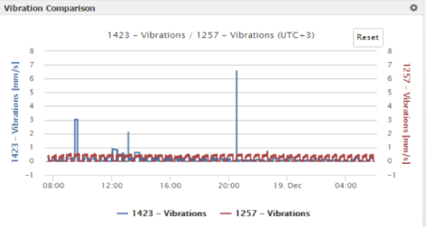
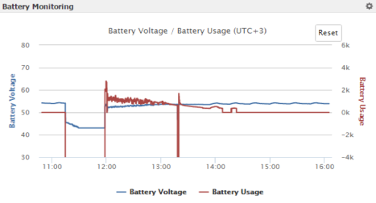
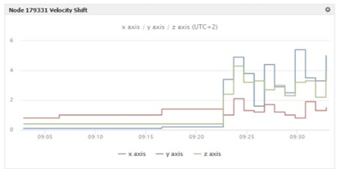
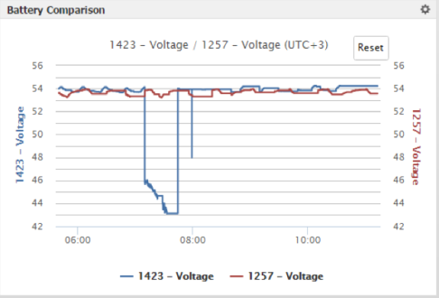
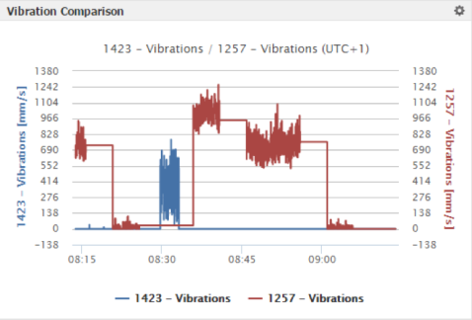
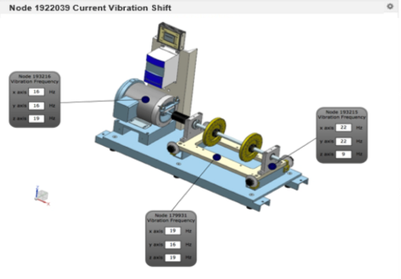
Equipment Health Monitoring Dashboard
Equipment Pressure Level
Notify when threshold exceeded
Vibration Trend
Notify when threshold exceeded
Equipment Power Consumption
Notify when threshold exceeded

Slide 43




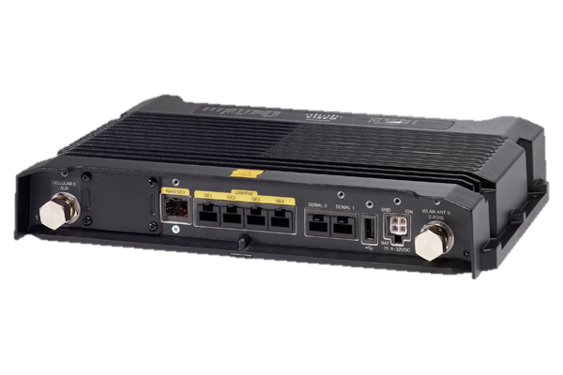
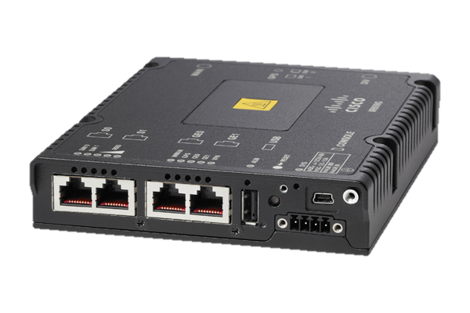



IoT Ecosystem to enable Data Collection and ERP Integrations
Enterprise
IT Systems
Analyze & Act
Business Agility
Integration of machine data with business logic running on Enterprise IT systems
Connectors to Enterprise Systems
Collect & Transform
OSIsoft Pi Server
Telit deviceWise Enterprise Gateway
Monitor critical operational data from multiple machines
Improved Overall Equipment Efficiency (OEE)
Partner Solutions
Edge Connectivity
OSISoft Pi Connector
deviceWise
Asset Gateway
IOx
Connect
IOx
IOx
Enable simplified access to machines and data
Connect siloed machines securely
Extract Operational data from the machines
Agents running on Cisco IoT Gateways
Machines

Slide 44
Digital Manufacturing Journey
- 49%
Defects
+ 16% OEE
+ 23%
NPI
- 48%
Downtime
- 35%
Inventory
Supply Chain
Orchestration
Connected
Enterprise
Supply Chain Collaboration (SXP)
Design Collaboration
Connected
Factory
Analytics & Big Data
Virtualization & Compute
Connected Machines
Factory Collaboration
Location Services
Off-Line
Factory Network
Factory Security
Factory Wireless

