Slide 1

3.0 The Evolution Of The Internet

Slide 2

A Telecommunication Service Provider Specialized in Dedicated Fiber Optics
For Businesses With Head Offices located
In Quebec and Ontario
FIBRENOIRE

Slide 3

3 Offices :
Montréal
Québec
Ottawa
110 employees
Over 10 000 connexion points
45 000 km
of fiber
FIBRENOIRE
Over 2 500
large enterprise
are customers
Over 45 COs

Slide 4

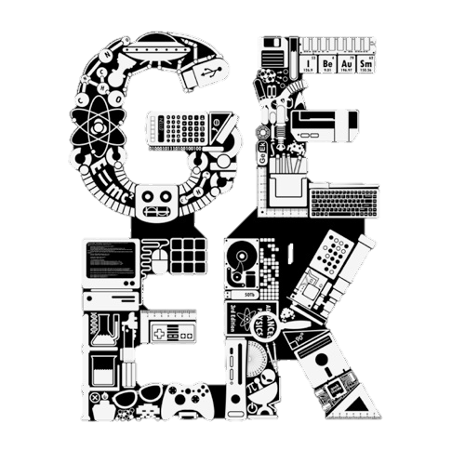
Talking about Internet
Fibrenoire is also…
FIBRENOIRE
Tier2 Internet Service Provider
Internet Service broken down with 3 types of inter-connections
  -Top Tier1 provisioning
  -Local and national ISP inter-connections
  -Over 400 direct peering sessions

Slide 5

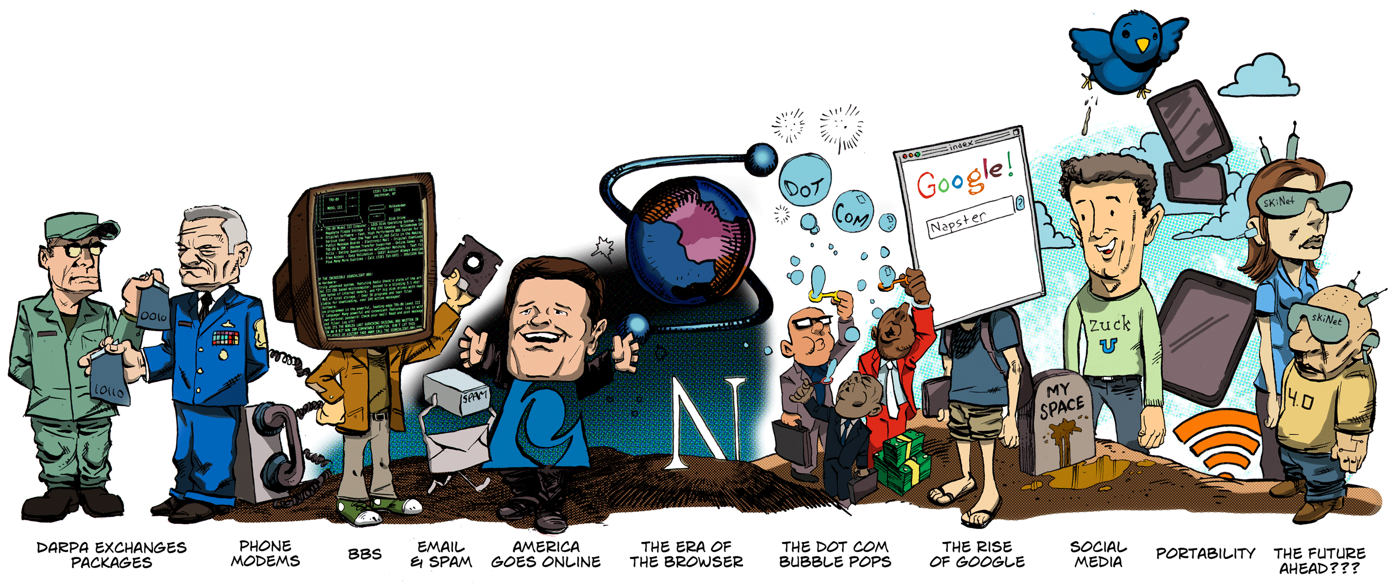
|------ Internet 1.0-----|
|--- Internet 2.0---|
2006
3.0
1997 to 2001
1969
1979
1991
1994
1998
THE EVOLUTION OF THE INTERNET
1984
Arpa becomes the Internet
2004-2010
Notes:
DARPA or Defense Advanced Research Projects Agency provided significant technologies that influenced many non-military fields, such as computer networking and the basis for the modern Internet, and graphical user interfaces in information technology. It is known today as the first data exchange network project that initiated the Internet.

Slide 6

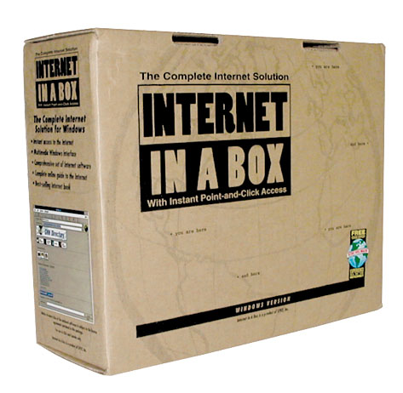
First time I ever heard of the Internet…
1994

Slide 7
My first job Interview…

Slide 8

Web 2.0
Notes:
Web 2.0 is marked by the beginning of Social Networks… But Why? Because Social Networking did two things for the Internet.. It changed the Internet from a static information platform to a platform that invites interactive exchange and collaboration between users.

Slide 9


The Social Networking ERA
What is a Social Network site?
A social networking site is an online platform that allows users to create a public profile and interact with other users on the website.

Slide 10
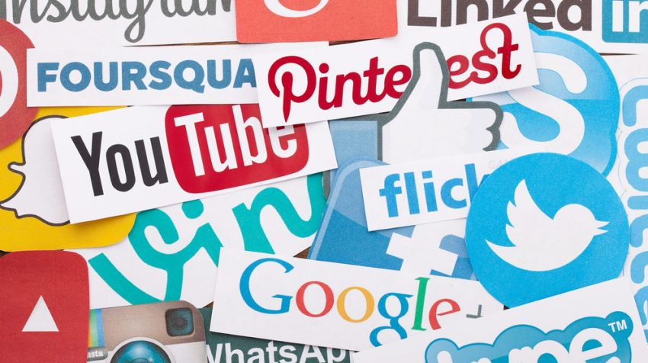
SOCIAL MEDIA SITES

Slide 11
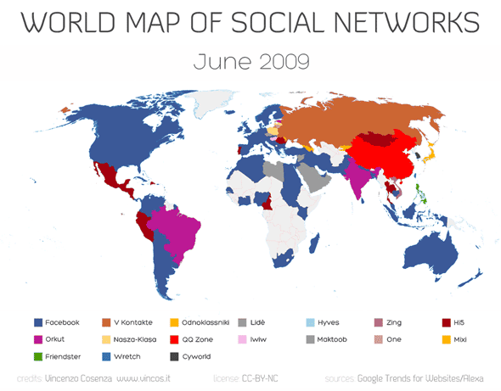
The World of Social Networks
Notes:
This map shows you how the landscape of Social Networks Grew from June 2009 through June 2013.. Where Facebook and VK or Vkontakte (social media popular among Russian speaking users).

Slide 12


Before Social Networking, the Internet was a Centralized platform
How Did Social Networking Change the Internet?
Centralized Model
Notes:
Centralized internet is the idea that the web is run from pocket networks keeping data information on localized servers.

Slide 13
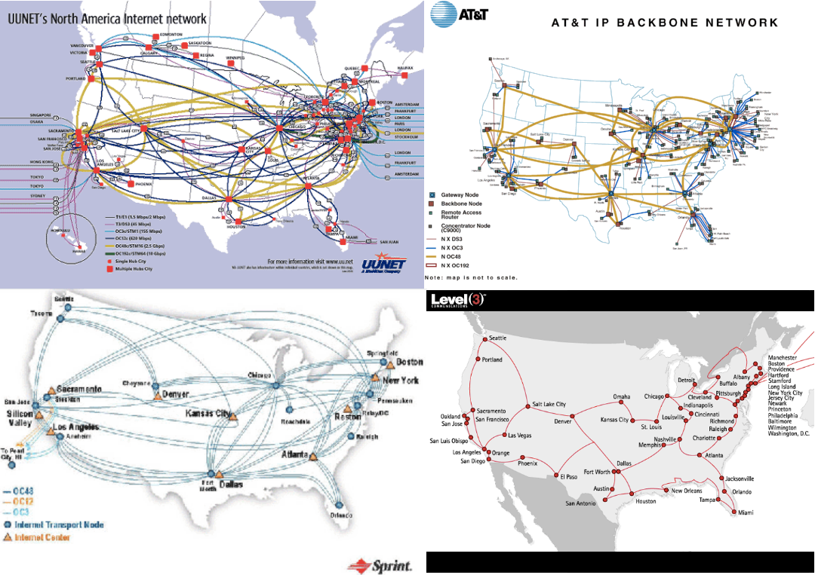
The Major Internet Backbone by year 2000
Notes:
Major Internet Backbones just grew exponentially by doubling their capacity every month . The wider the spand of the Network, the

Slide 14
How Did Social Networking Change the Internet?
The Internet has now decentralized in a way that it is now spread amongst its users
Decentralized Model
Notes:
Decentralized internet is the idea that the web is run across a number of machines that are owned by regular users rather than owned in a central place like a server.

Slide 15
How does that impact our Internet??
Usually mostly resellers that purchase mostly from Tier 2
Internet Service Providers
Tier 3
Internet Service Providers
Regional or National Internet Backbone that purchases from Tier 1 or other Tier 2 Providers
Tier 2
Tier 1
Worldwide Coverage with their Internet Backbone
Notes:
The Internet as of age, have relied on this current structure. Smaller Internet Service Providers purchase connectivity from a handful of companies that operate long-distance networks (Internet Backbone).

Slide 16





Since the Internet is decentralized, It is no longer about how large the service provider’s network is but how well they’re interconnected to the content you need!
The Internet is changing
Notes:
The more inter-connection a service provider has today to pertinent destination a user requires, the better the customer experience will be!

Slide 17

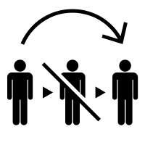

If you’re a local Internet Service Provider that gets milked by the larger Tier1 Internet backbone, what’s your play?
Transit
Networks
Notes:
The model that is becoming increasing popular is the one where service provider try to negotiate directly with content providers for direct access to their services or content…
Less latency, controlled quality of content delivery, better customer experience…

Slide 18


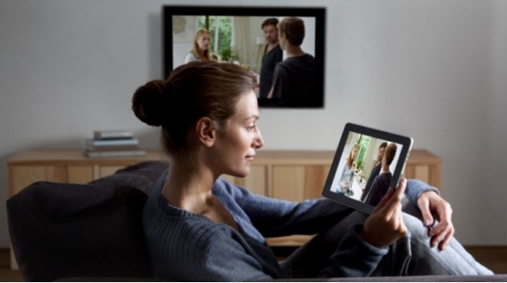
Tier1 Service Provider
Tier2
ISP
The Concept of Network Neutrality
Congestion
Customer
?%$&$!!
Complains
Content Provider
?%$&$!!
Complains
Notes:
Since ISP’s have the option to reach content providers by using an upstream or third party provider or connecting directly to the content itself, the neutrality of the Internet is threaten. Your service provider has to pay to inter-connect its network to larger backbones… What happens if they decide to stop paying third party networks? You end up with a congestionned network.

Slide 19

Who’s paying who?
Notes:
In this real case scenario, Comcast was paying dues to their upstream providers. Problem is, Netflix felt like Comcast should upgrade its links with its upstream providers because customer’s experience is not so great.. Comcast comes up with the idea of cutting the middleman but seeks out money from Netflix for a better user experience. Netflix feels

Slide 20




Competition!!!
Tier2
ISP
The Concept of Network Neutrality
No WAY!!!!
Notes:
Since ISP’s have the option to reach content providers by using an upstream or third party provider or connecting directly to the content itself, the neutrality of the Internet is threaten. Your service provider has to pay to inter-connect its network to larger backbones… What happens if they decide to stop paying third party networks? You end up with a congestionned network.

Slide 21
Web 3.0
Notes:
Now what is this next wave, the Internet 3.0?!!
A more Intelligent web using artificial intelligence which understands context rather than simply comparing keywords
The Intent is making our lives easier and more intuitive as smarter applications such as better search functions give users exactly what they are looking for..

Slide 22
Rush of the Intelligent application to consumers
The Internet Of Things…
Connected objects interacting with one another tailored specificaly for you in the context of what you like, what you want.. Instantly!!
Notes:
Now what is this next wave, the Internet 3.0?!!
A more Intelligent web using artificial intelligence which understands context rather than simply comparing keywords
The Intent is making our lives easier and more intuitive as smarter applications such as better search functions give users exactly what they are looking for..

Slide 23
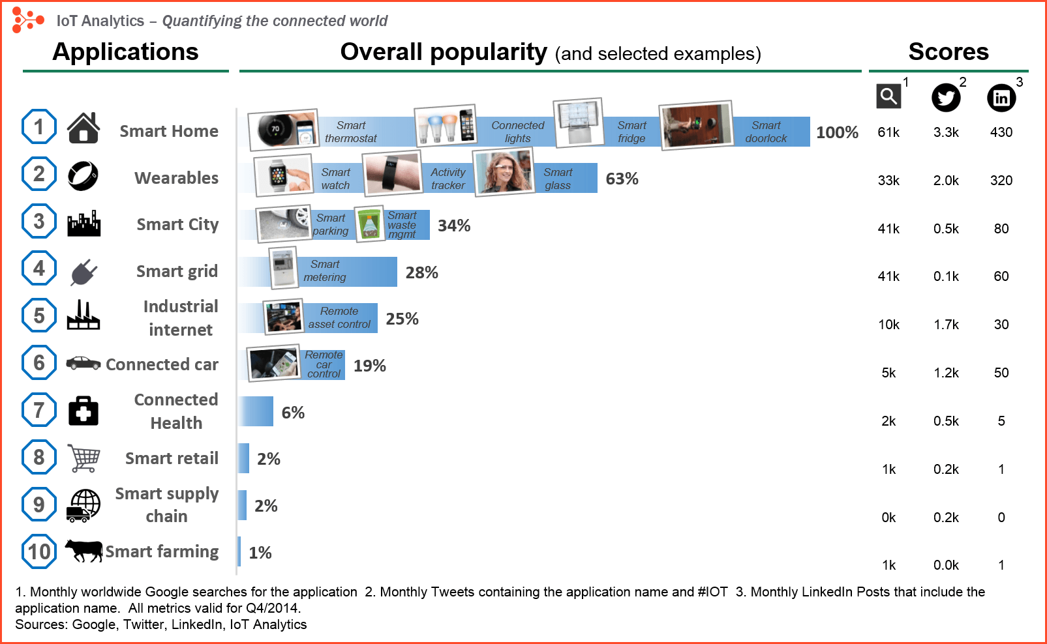

Some IOT Applications
Notes:
In 2018, almost everything you buy has a ‘smart version’… These smart object are connected seamlessly and gather information that gets passed around, analysed with every context possible.. All in the good will of making our life’s easier.

Slide 24
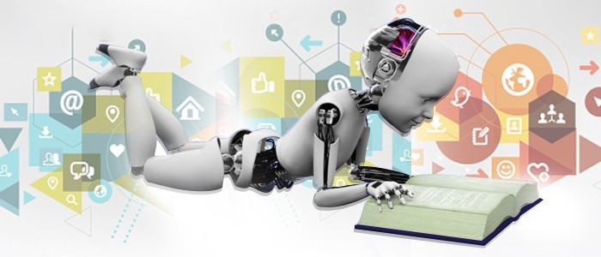
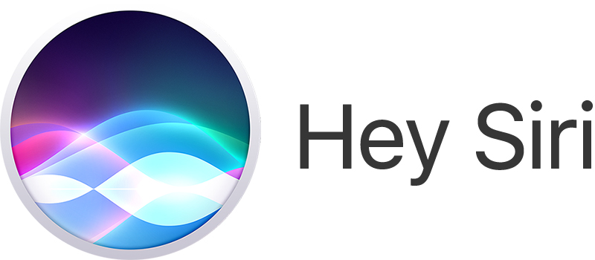
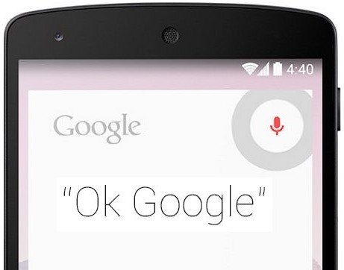
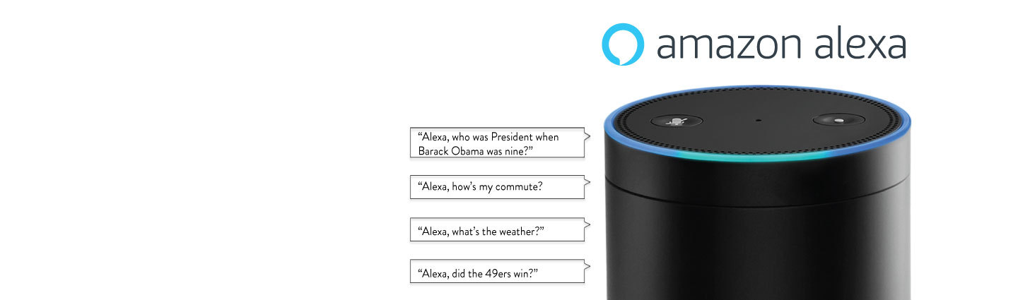
Artificial Intelligence is everywhere
Notes:
Our Personal assistants take in information everyday… Every question you ask SIRI, GOOGLE or Alexa is searched upon, analyzed in context to give you an intelligent response.

Slide 25
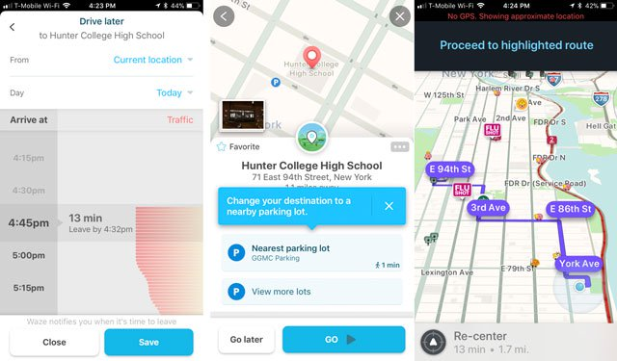
Artificial Intelligence is everywhere
Notes:
Even in the way our GPS analyses your daily routes, analyses your usual schedules and make predictions on when you should leave what routes you should take, where there’s an accident ahead of your travel routes, and modify your route on the go all through AI…

Slide 26
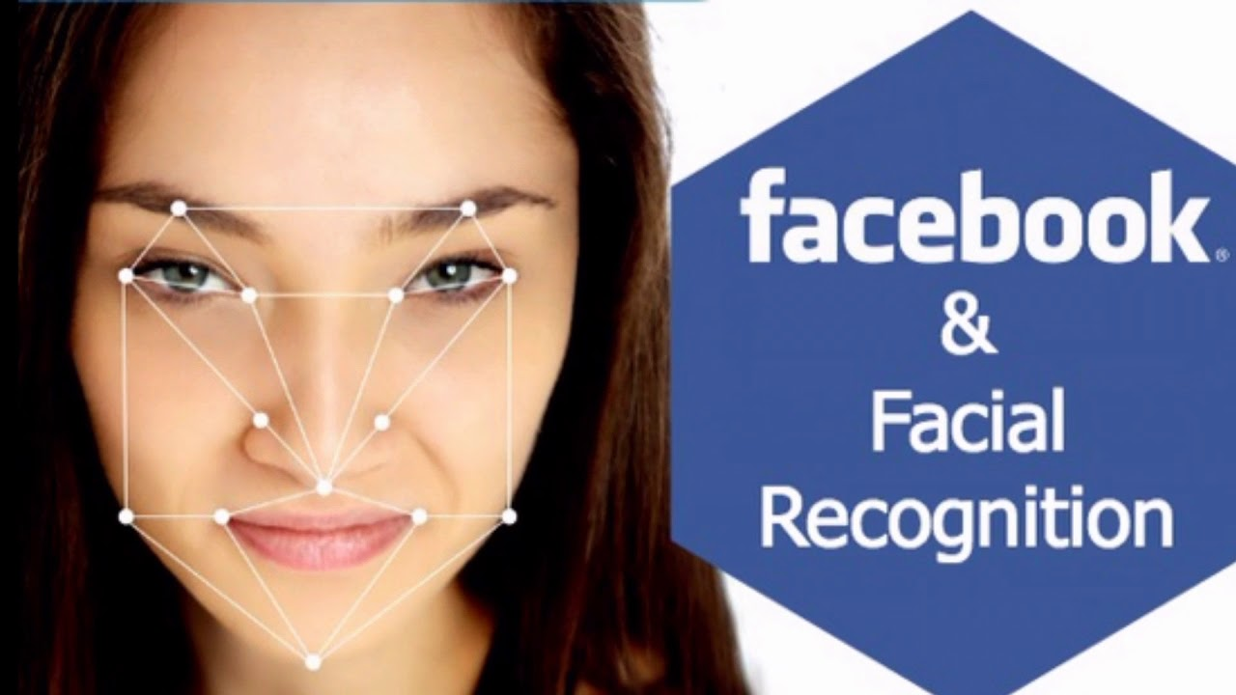
AI even in your Social Media Services
Facebook proposes to analyse your shared pictures and send you alert when someone other than you post or try to use your picture in their profile…
Okay… But I see something else coming…

Slide 27

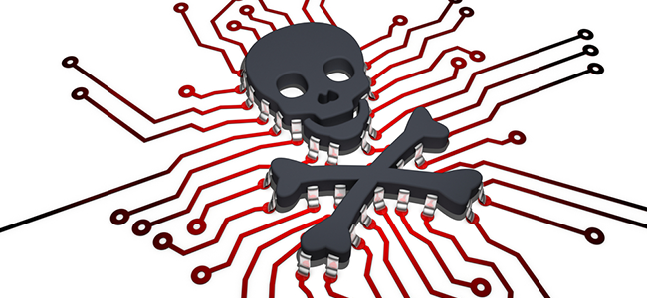
AI for Email Spam and Malware Filtering
Multi Layer Perceptron, C4.5 Decision Tree Induction.. All AI based tools to control email Spam more efficiently
MALWARE!!
Over 325 000 malwares are detected everyday! AI powered systems understand coding patterns, detect and protect against them

Slide 28

AI in customer support applications
Did you know?
A number of websites nowadays offer the option to chat with customer support representative while they are navigating within the site. However, not every website has a live executive to answer your queries…

Slide 29
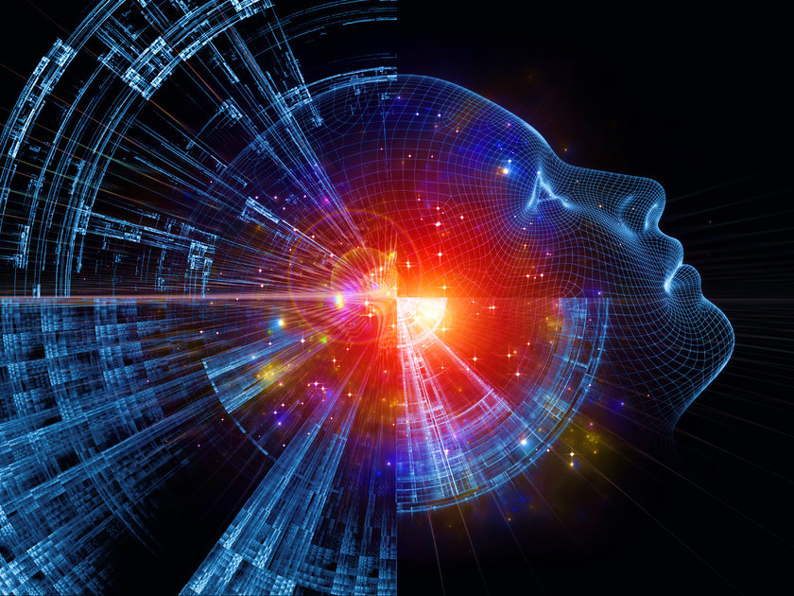
Web 3.0
WEB 3.0 is an intelligent WEB where interactions of machines and people happens seamlessly…
Notes:
There are thousands of applications being developed around an Intelligent web, every interaction you make with the web contains information that can be used to sell you services, improve your future purchases, etc.. It changes the way we use the web, the way we think of our privacy, in a way we have not yet figured out it could.
Machine learning and data storage of what is collected will impact every sphere of our lives. Are you ready for Web 3.0?

Slide 30


